Slide 1
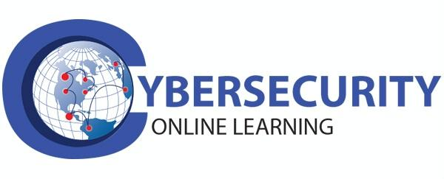

Slide 2
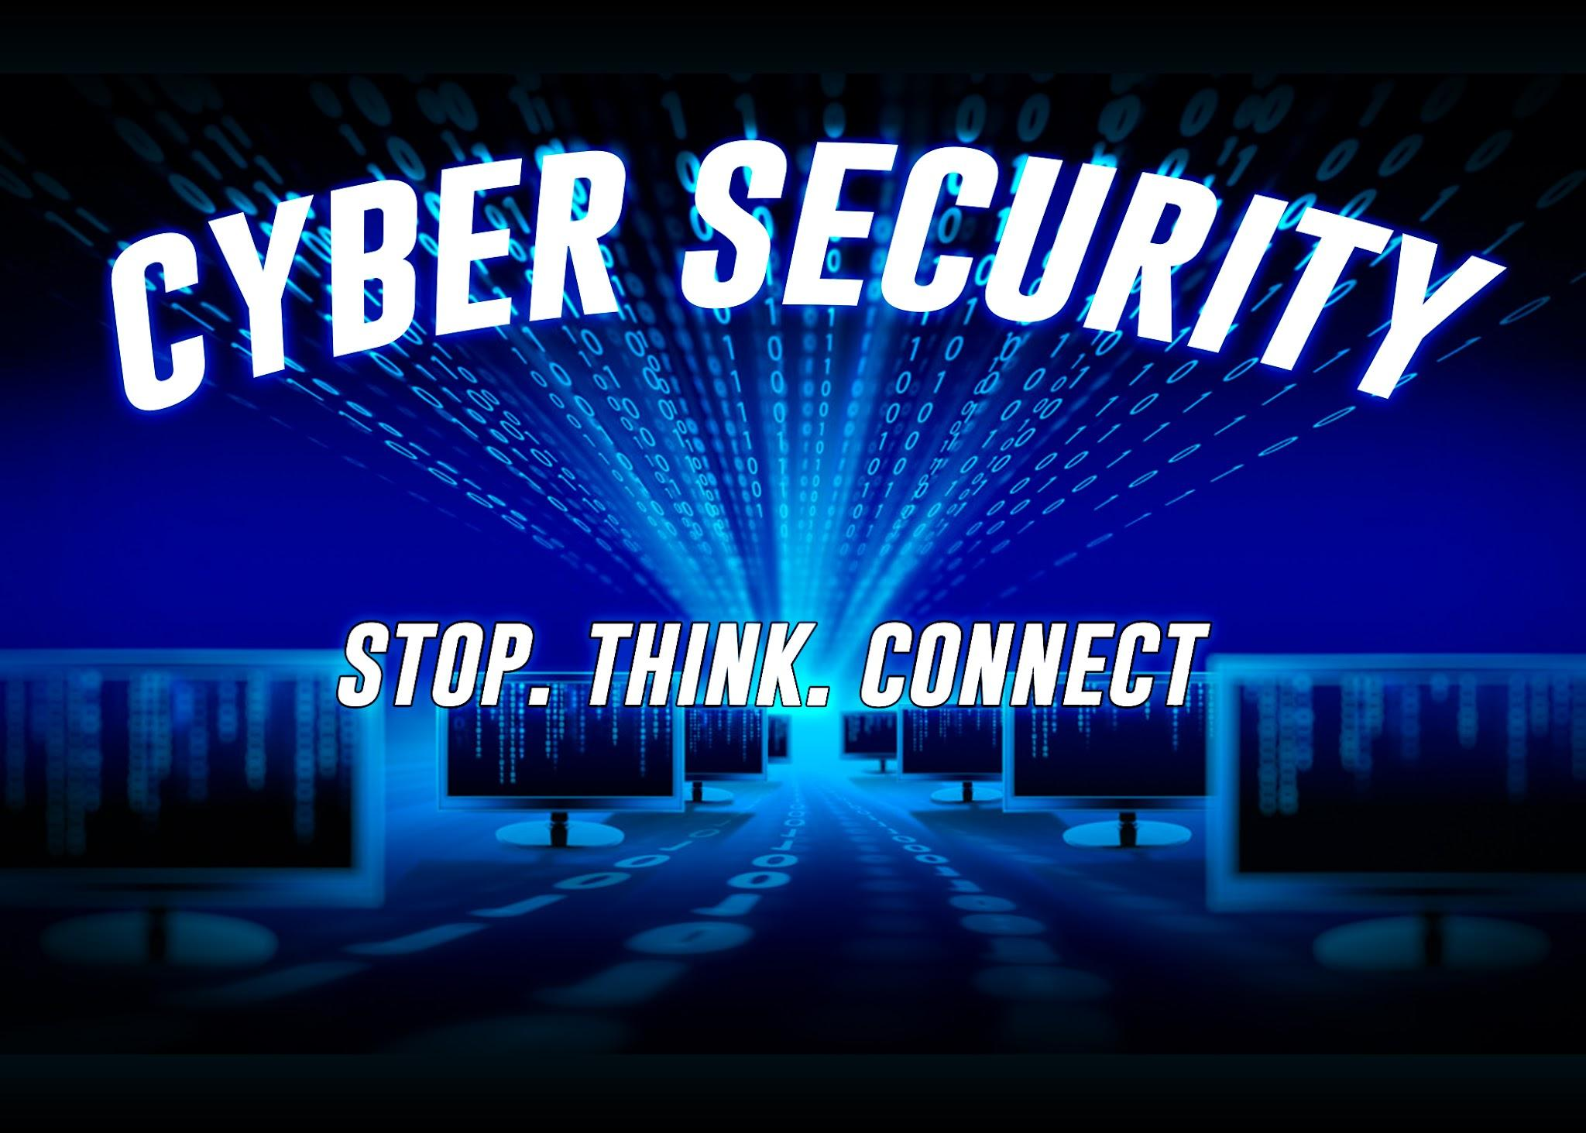

Slide 3


Slide 4


Slide 5
Week 1 - Course Module
Understanding Threats, Attacks & Vulnerabilities
Introduction to Security Concepts
Identifying Threat Actors and Vectors
Understanding Vulnerabilities
Understanding Attack Types
Identifying Social Engineering Techniques

Slide 6

Understanding Threats, Attacks & Vulnerabilities
Threats: Potential dangers to information systems, including malware, unauthorized access, and data breaches.

Slide 7

Vulnerabilities: Weaknesses in systems or processes that can be exploited by threats.

Slide 8
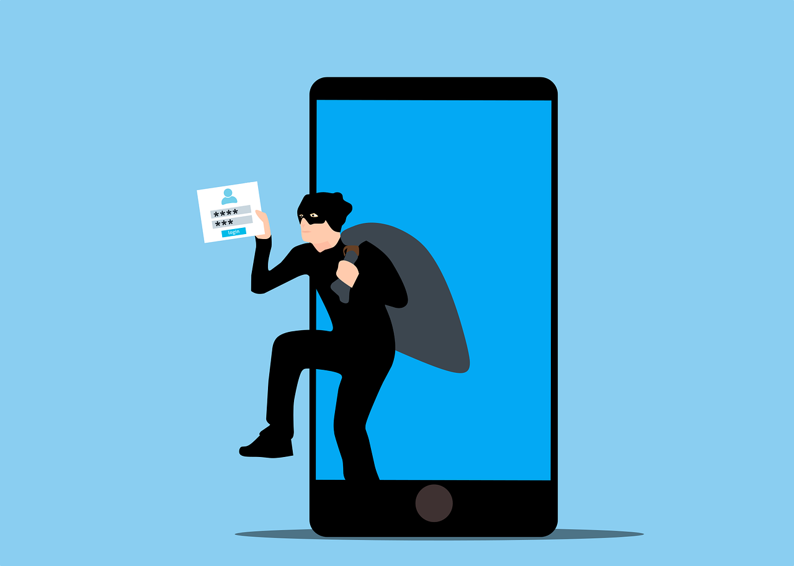
Attacks: Deliberate actions that exploit vulnerabilities to compromise security (e.g., denial-of-service attacks, phishing).

Slide 9

Summary & Evaluation

Slide 10


Questions

Slide 11
Assignment
What is buffer overflow, insecure configuration and SQL injection and how do we prevent them.
What is a ransomware, botnet and spyware?

Slide 12
Buffer Overflow:
A buffer overflow (or buffer overrun) occurs when a program writes data beyond the allocated memory buffer, overwriting adjacent memory locations.
Buffers are temporary memory storage areas used during data transfer within a program or between programs.
Attackers exploit buffer overflows to manipulate program execution, potentially compromising data or even gaining unauthorized access to systems12.

Slide 13
SQL Injection (SQLi):
SQL injection is a web security vulnerability where an attacker interferes with an application’s database queries.
By inserting specialized SQL statements into input fields, the attacker can retrieve data, modify content, or even compromise the underlying server.
Successful SQL injection attacks can lead to unauthorized access to sensitive data (e.g., passwords, credit card details) and have caused high-profile data breaches34.

Slide 14
Insecure Configurations:
Insecure configurations arise when hardware, software, or network components are not properly set up or configured.
These vulnerabilities expose systems to potential cyber threats.
Regular security audits, robust configuration management, and adherence to security best practices are essential to address insecure configurations and reduce attack surfaces.
Once executed, an exploit gains unauthorized access, alters system behavior, or compromises data.

Slide 15
Ransomware:
Ransomware is a type of malicious software that encrypts files or locks users out of their systems, demanding payment (usually in cryptocurrency) to restore access. It’s like digital extortion. Cybercriminals use it to hold data hostage, affecting individuals, businesses, and even government organizations1.

Slide 16
Botnet:
A botnet is a network of compromised computers (often called “bots” or “zombies”) that are controlled remotely by a single entity. These bots can be used for various purposes, such as launching distributed denial-of-service (DDoS) attacks, spreading malware, or sending spam emails. Botnets are powerful because they can coordinate large-scale attacks without the owners’ knowledge.

Slide 17
Spyware:
Spyware is covert software installed on a computer without the user’s consent. Its purpose is to gather information about the user’s activities, such as browsing habits, keystrokes, and personal data. Spyware can be used for surveillance, identity theft, or unauthorized data collection.

Slide 18

Next
Class

Slide 19
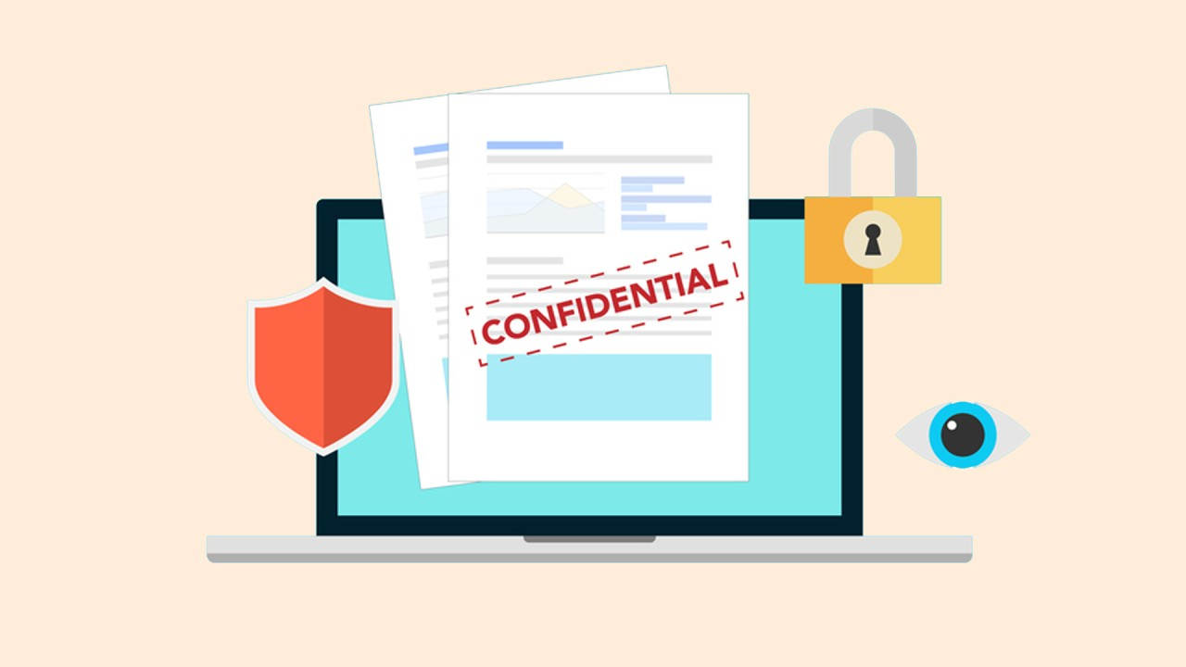
Introduction to Security Concepts:
Confidentiality: Ensuring that sensitive information is accessible only to authorized users.

Slide 20
Practical Steps to Ensuring Confidentiality
o Implementing access controls
o Encrypting data
o Regularly auditing access logs

Slide 21
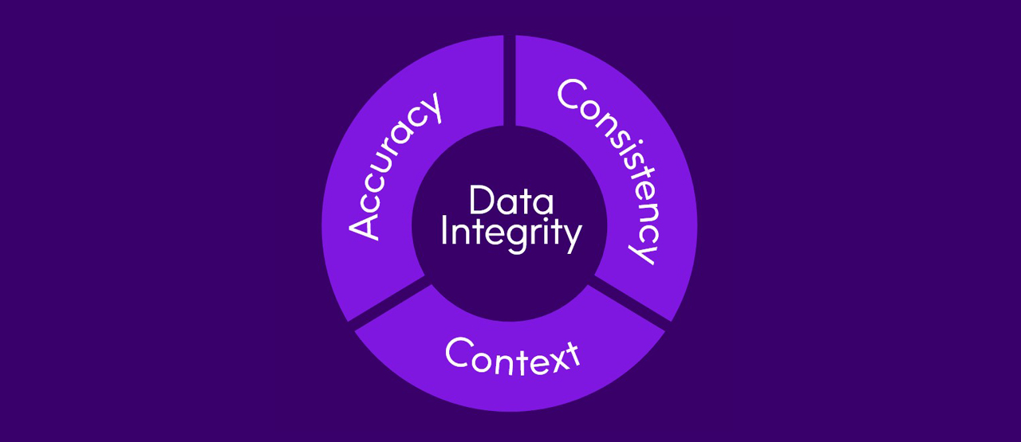
Integrity: Maintaining data accuracy and preventing unauthorized modifications.

Slide 22
Practical Steps
Consider these actions:
▪ Version control
▪ Backup systems

Slide 23

Availability: Ensuring systems and data are available when needed.

Slide 24
Practical Steps:
Ensuring systems and data are available when needed involves:
o Redundancy
o Load balancing
o Monitoring

Slide 25

Authentication: Verifying user identities.

Slide 26
Practical Steps
Verifying user identities is essential. Methods include:
Passwords
Multi-factor authentication (MFA)
OAuth or OpenID Connect

Slide 27
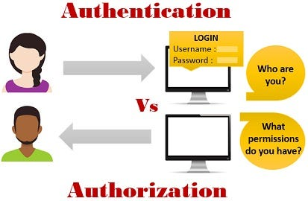
Authorization: Granting appropriate access rights.

Slide 28
Practical Steps:
Granting appropriate access rights involves:
Role-based access control (RBAC)
Attribute-based access control (ABAC)
Regularly reviewing access rights

Slide 29
Identifying Threat Actors and Vectors:

Slide 30
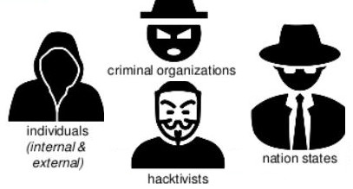
Threat Actors: Individuals, groups, or organizations that pose security risks (e.g., hackers, insiders, nation-states).

Slide 31
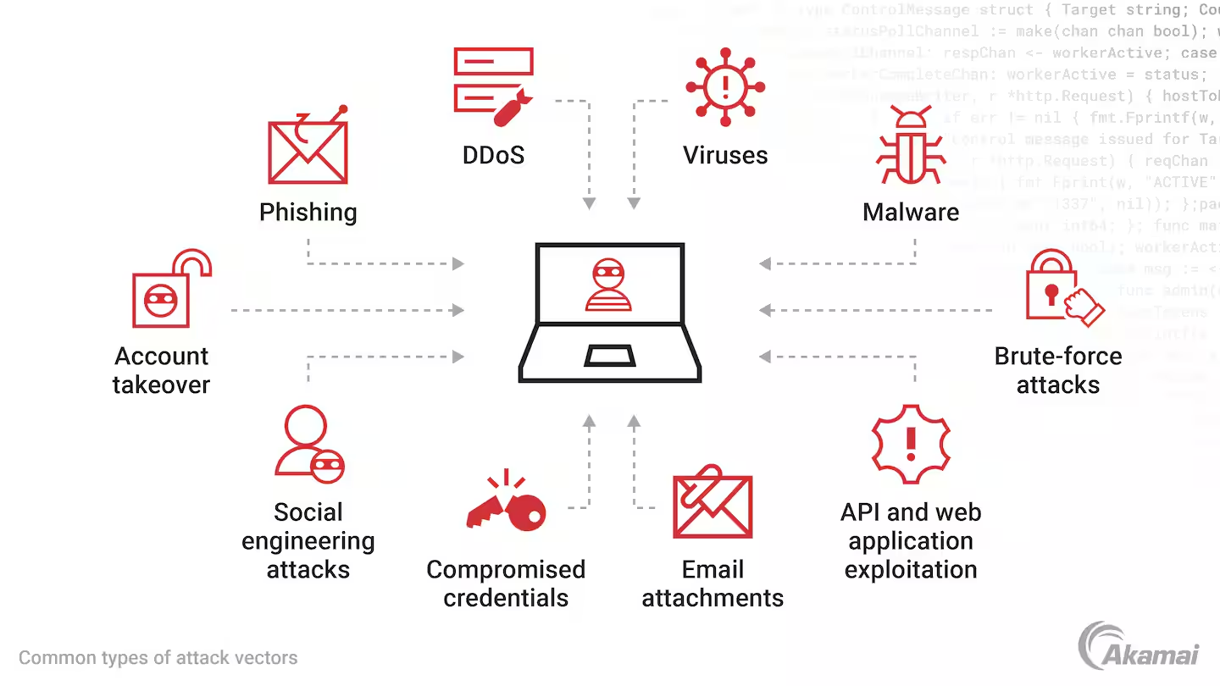
Attack Vectors: Paths or methods used by threats to exploit vulnerabilities (e.g., email attachments, software vulnerabilities).

Slide 32
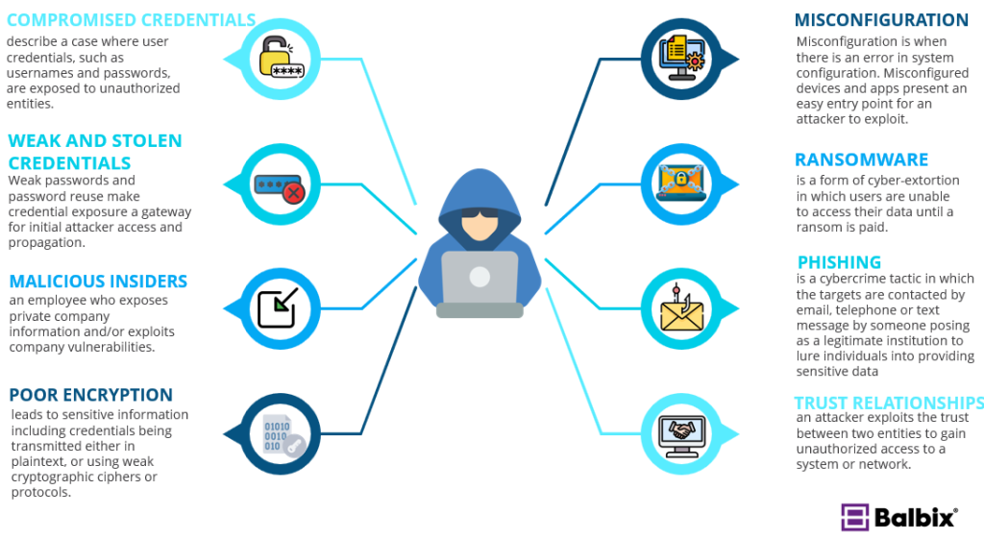

Slide 33
Understanding Vulnerabilities:
Software Vulnerabilities: Flaws in software code that can be exploited (e.g., buffer overflows, SQL injection).
Human Vulnerabilities: Mistakes made by users (e.g., weak passwords, social engineering).

Slide 34
Understanding Attack Types:
Malware: Software designed to harm systems (e.g., viruses, worms, ransomware).
Network Attacks: Exploiting weaknesses in network protocols (e.g., man-in-the-middle attacks).
Physical Attacks: Unauthorized access to physical devices or locations.

Slide 35
Identifying Social Engineering Techniques:
Phishing: Deceptive emails or messages to trick users into revealing sensitive information.
Pretexting: Creating a false scenario to manipulate individuals into divulging information.
Tailgating: Unauthorized entry by following an authorized person into a secure area.

